Slide 1
Webserver
(Node MCU)
HTTP request
Webpage
(User)
HTTP reply
Webserver is implemented in the Node MCU.
According to the HTTP requests sent by the user, operations are carried out.
Location set up data sent by the user is sent to the Node RED and receive the weather details.
Received weather data sent to the webpage.
According to the selected method, watering is done.
Designed using HTML, CSS and JavaScript.
User commands is sent to the Node MCU as HTTP requests.
Location Setup
Mode Selection
Watering
A Clock will be running in order to synchronize the sleeping schedule with the Node MCU. This will be further discussed later.

Slide 2
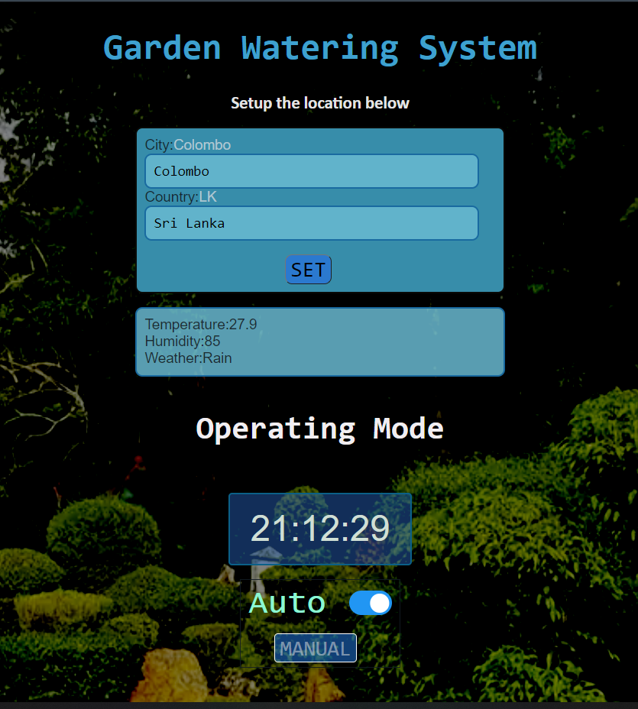
To set up the location
Current Location Weather Details
Toggle between AUTO and MANUAL
When set to MANUAL, this can be used to manually water the plants

Slide 3
Location setup
Location set data
sent via MQTT
Node RED
Location Set data
Node MCU
Location Set data
Webpage
Weather Data
Weather Data
Weather Data is used to adjust the watering.
AUTO
Node MCU
AUTO enable
Webpage
AUTO enable confirm
AUTO watering happens as programmed.
MANUAL
Node MCU
MANUAL enable
Webpage
MANUAL enable confirm
Manual Watering
Manual Watering Confirm
Manual Watering

